Slide 1

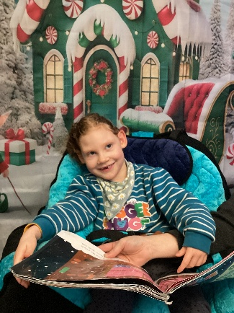
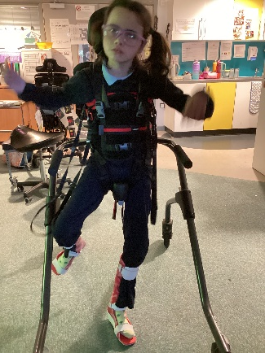
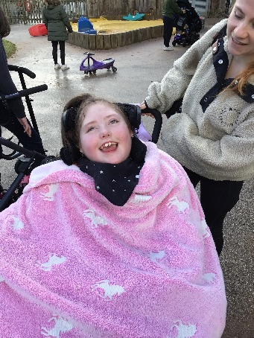
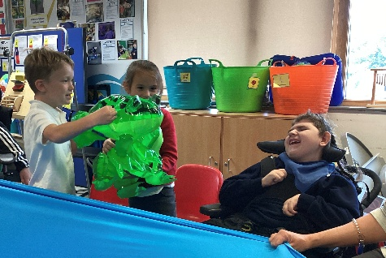

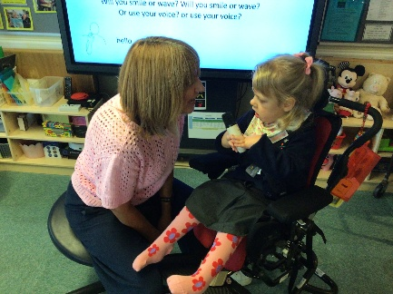
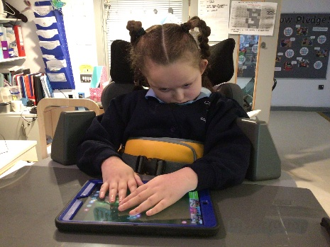
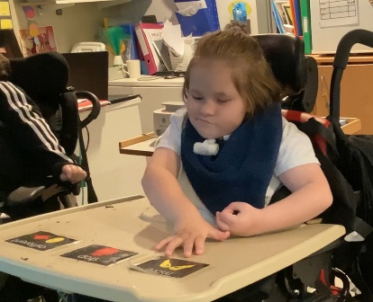
Learning in Sennen
A typical day in Sennen:
9:15am -10:30am Arrive at school and enjoy listening to music of the day (different genre of music for each day). Standers. Good morning registration time, individual phonics – letter of name, listen and watch it being written. Mirror work and looking at photograph of self and of friend, colour of the days, 1-1 focused activities and active adult and peer interaction time.
10:30am-11:00am Snack followed by choice making, favourite toys, switch activities or eye-gaze (personal independence targets)
11:00-11:30pm Whole group curriculum based communication / cognition focused learning including Music, Sensory story, Sensology, Sensory Art or Outdoor Learning.
11:45am -12:00pm Talking time, Sound bath, changing routines
12.00pm-13.30pm Lunch 1:1 supervision/support as required & personal care/meds administration changing routines. Outdoor Play (Communication targets/PHSCE) and /or 1-1 and small group time for adult and peer interaction time, TV time – counting songs, class games.
1.30pm-2:00pm Good afternoon circle session (communication & interaction, SEMH) Hand-skills (Physical, Cognition and learning)
2:00pm-2.30pm Floor time Massage story, Tacpac, Therapy, Movement story, PE.
2.30pm-3.30pm Snack End of day personal care routines, Sound bath, relaxation
NB: Opportunities for pupil’s to practice personal learning targets and therapy goals are woven throughout the range of activities experienced each day.

