Slide 1
Pupil Well- Being
We recognise that all the pupils attending Curnow have additional needs and require a range of support strategies to maintain their well-being to enable them to access and achieve their learning outcomes. We recognise that positive relationships between staff and pupils are a major influence in encouraging good behaviour and positive well-being. We aim to establish a safe and caring environment that provides encouragement, structure, order, a sense of community and high quality education. The pupils experience positive behaviour for learning approaches and management systems employed will be consistent, taking into account every pupil’s individual needs.

Slide 2
Pupil Well- Being
At Curnow School, we ensure that all leaners are valued as individuals and support their well-being through:
Our curriculum – being interesting, engaging and appropriate to their needs, age and stage of development
PSHE and RSE curriculum in supporting and developing their personal and social skills
The Education, Health and Care plan process ensuring personalised outcomes for all pupils
A fully trained TiS practitioner Pupil Well-Being Lead
Pupil Well-Being Warriors in every class across both lower and upper school sites to support the embedding of TiS strategies into daily practice
Team Teach and the awareness of behaviour management and the focus and priority being on de-escalation and understanding behaviour as communication.

Slide 3
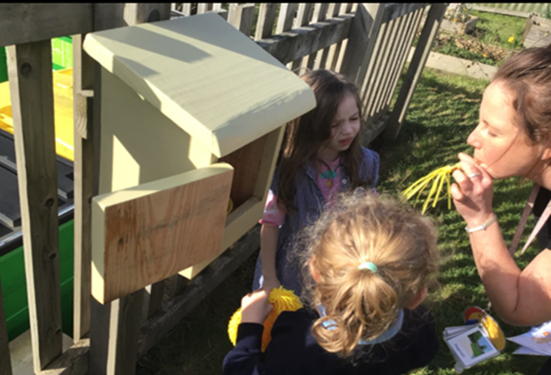
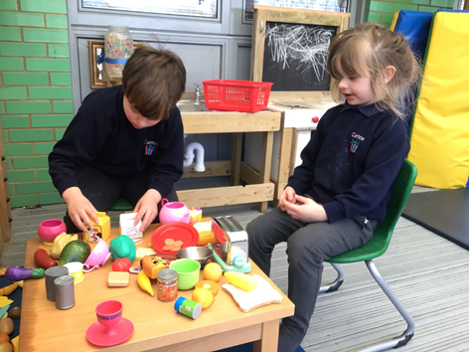
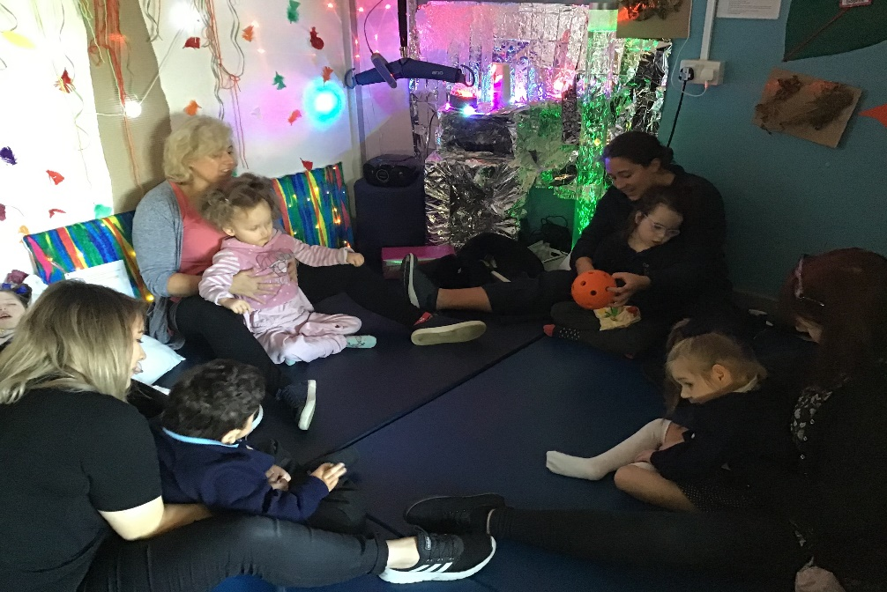
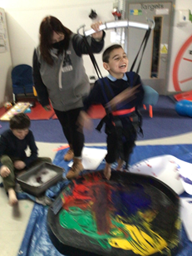
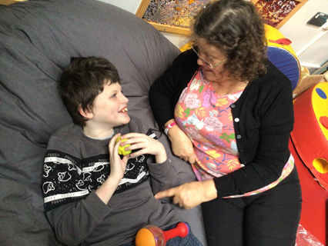
Pupil Well- Being
We support well-being by providing lots of opportunities for Emotional Regulation, Release and Replenishment. We do this in a host of ways at Curnow School:
Learning Outdoors
Role Play Opportunities
Learning together
Emotional Attunement
The Creative Arts

Slide 4
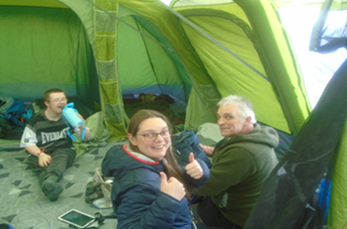
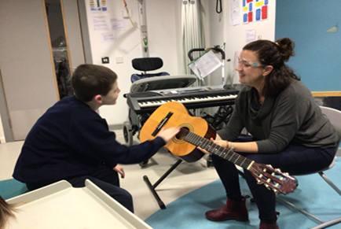
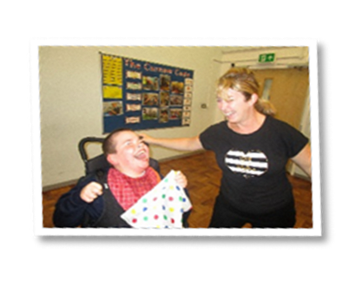
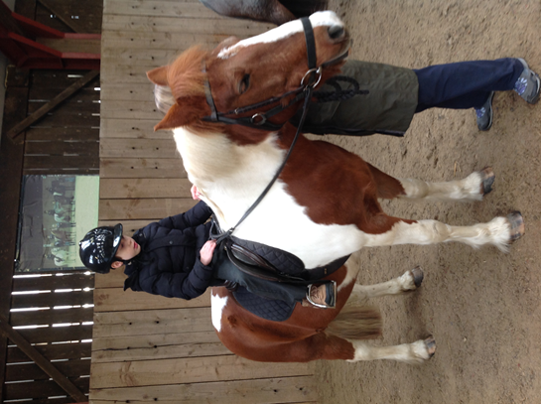
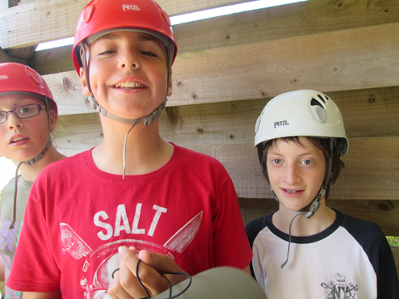
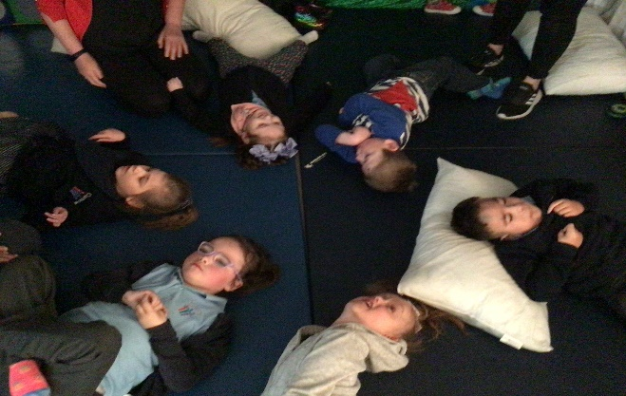
Pupil Well- Being
We also support our pupils well-being by training staff in additional therapies and by working in partnership with other professionals alongside participating in other events in the community such as:
Ten Tors
Music Therapy
Yoga Sessions
Dance Lessons
BF Adventure
Horse Riding

Slide 5
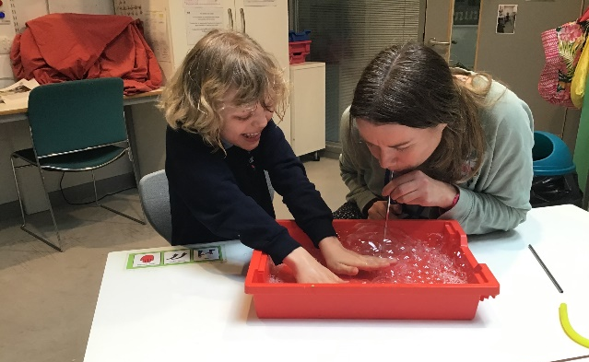
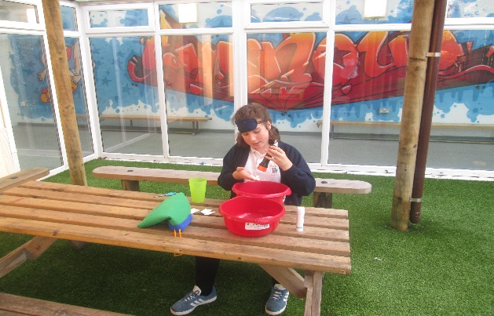
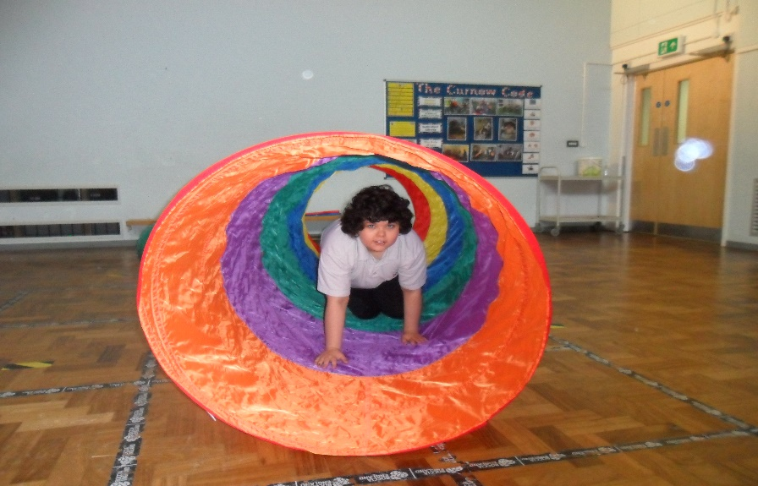
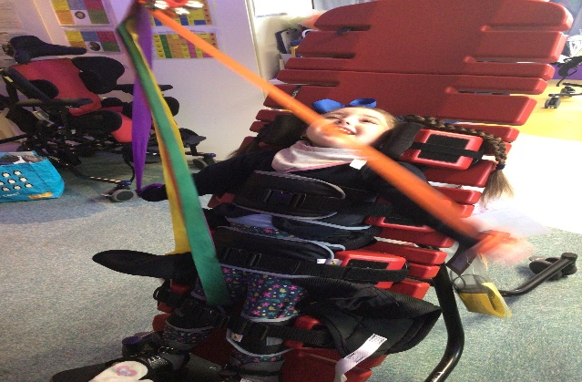
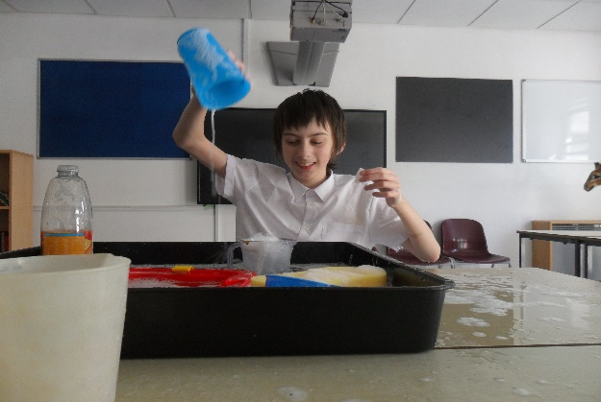
Pupil Well- Being
Some of our pupils require additional support to regulate and support their well-being in order to learn. We support and develop this in a number of ways such as Sensory Passport, Well-Being IEP’s, Therapy Programmes and Well-Being Plans
One to One Well-being Activities
Independent Well-Being Activities
Sensory Passport Activities
Physical Therapy Activities
Sensory Regulation Activities

